Slide 1
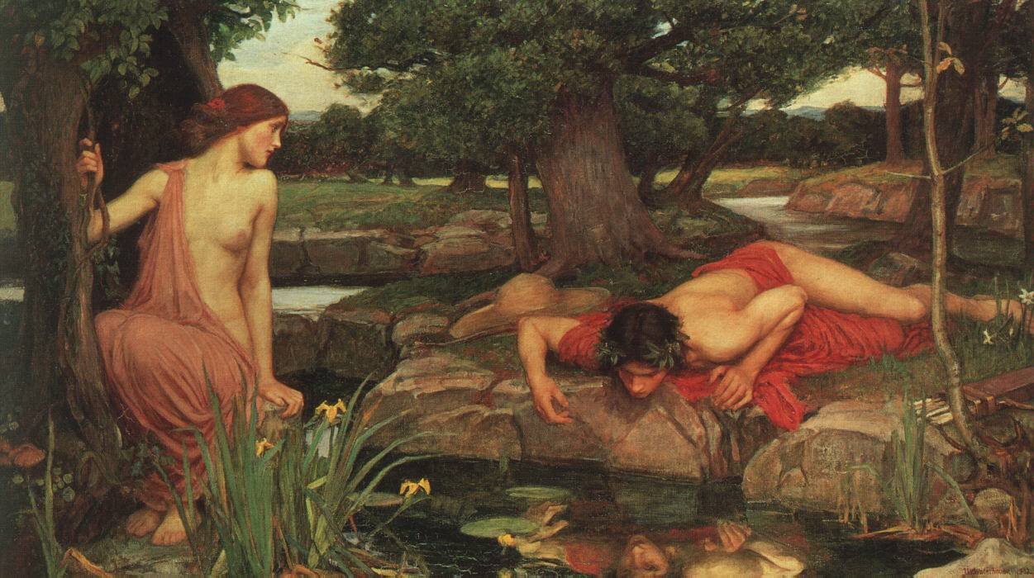
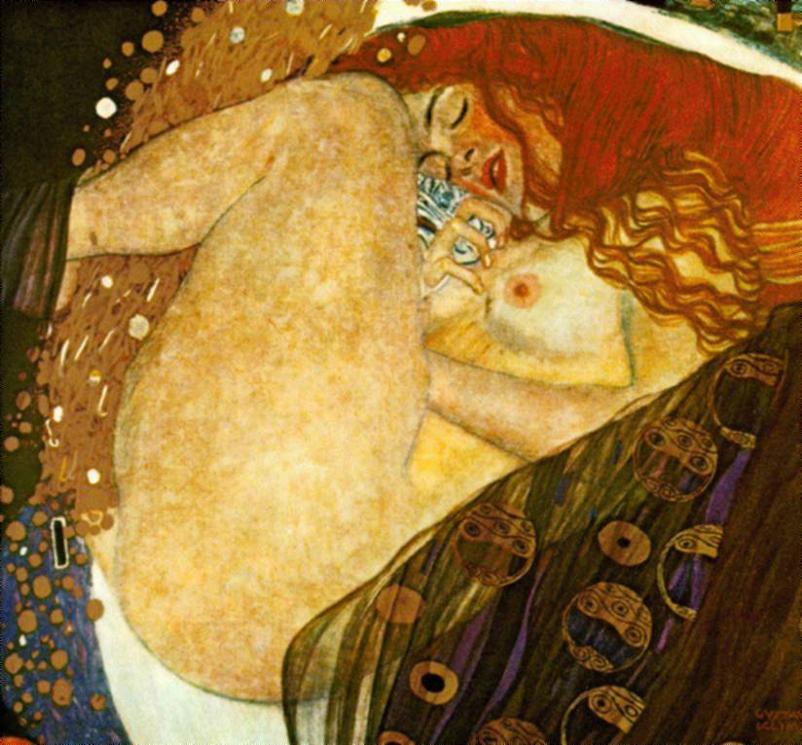
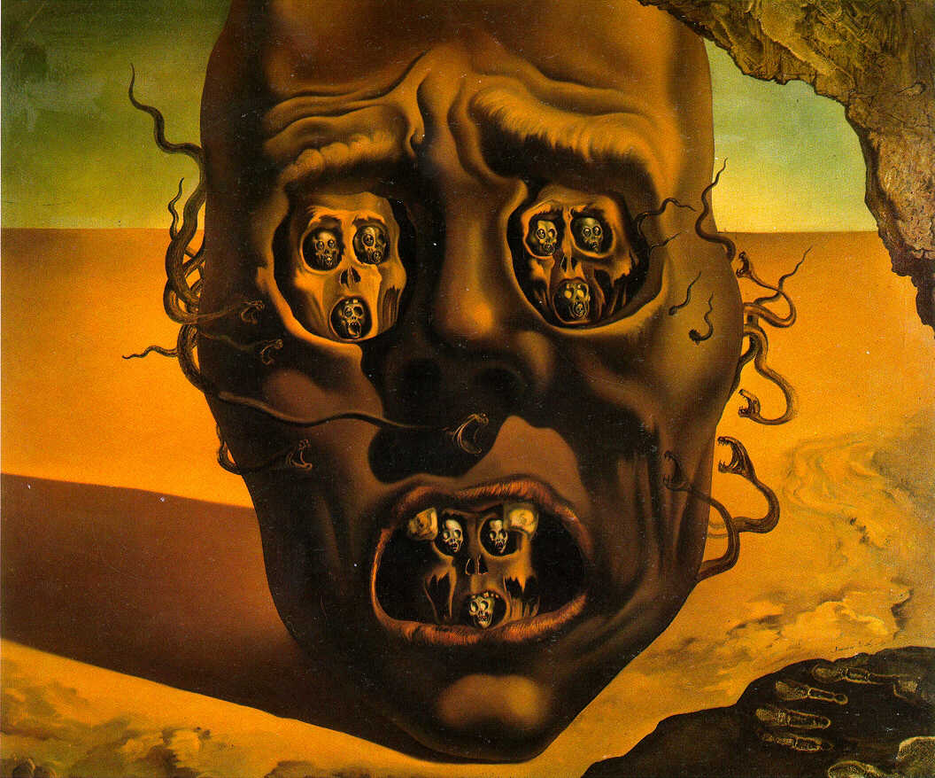
Sara Vega
Class 6B Exam Power Point
Notes:
Sar

Slide 2
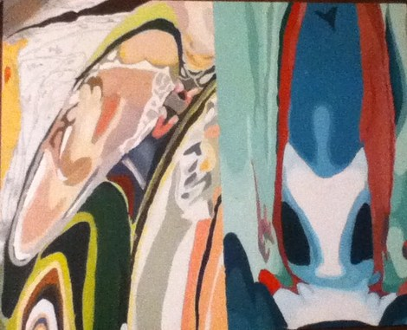
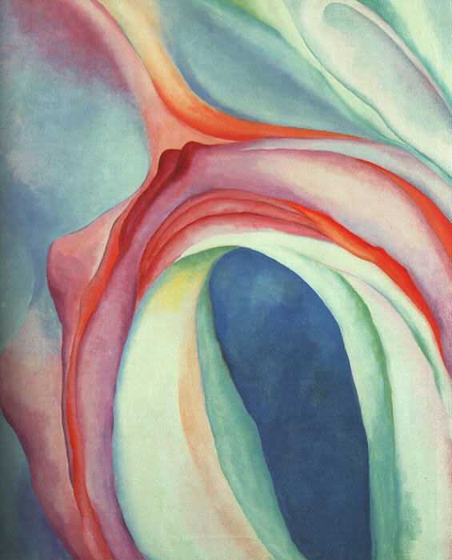
Crystal Acrylic on Board November 2011
20” x 16”

Slide 3
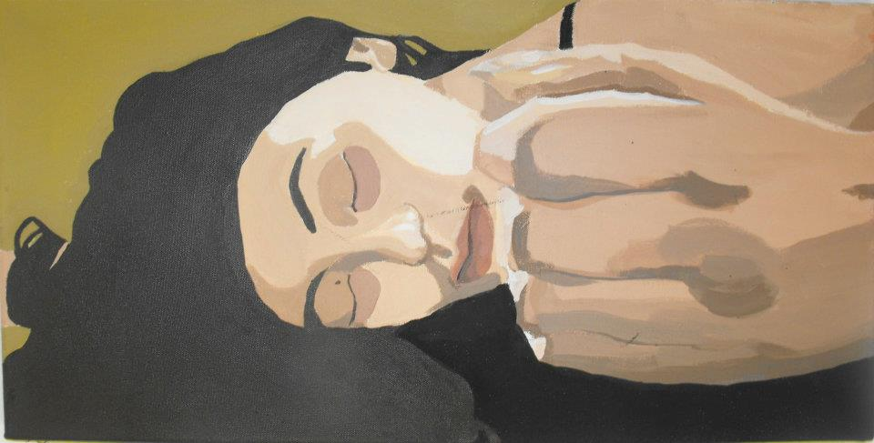
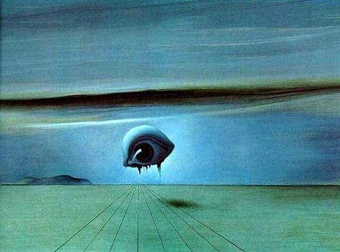
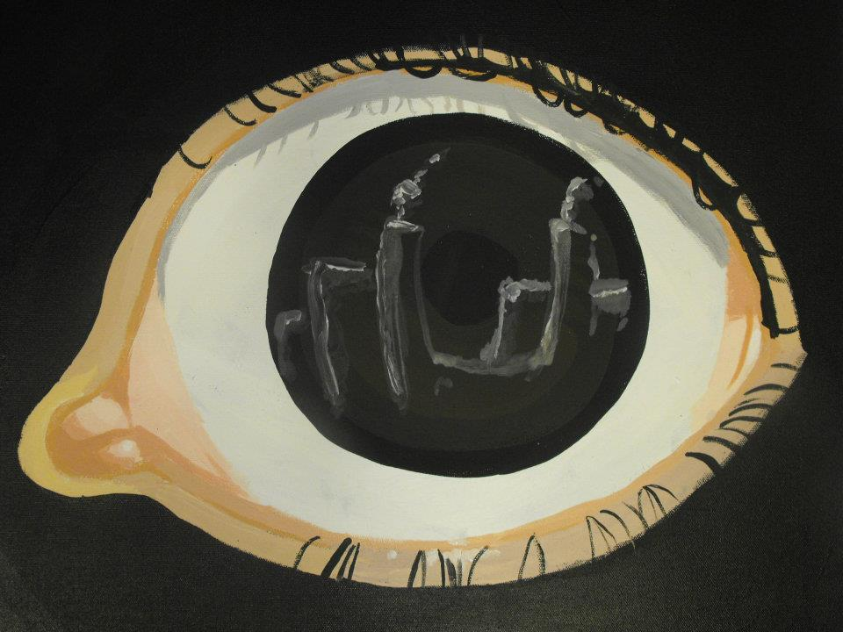
Artist and City in the Artist Acrylic on Canvas December 2011 61cm x 30.5 and 61cm x61cm

Slide 4
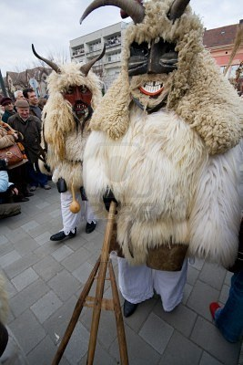
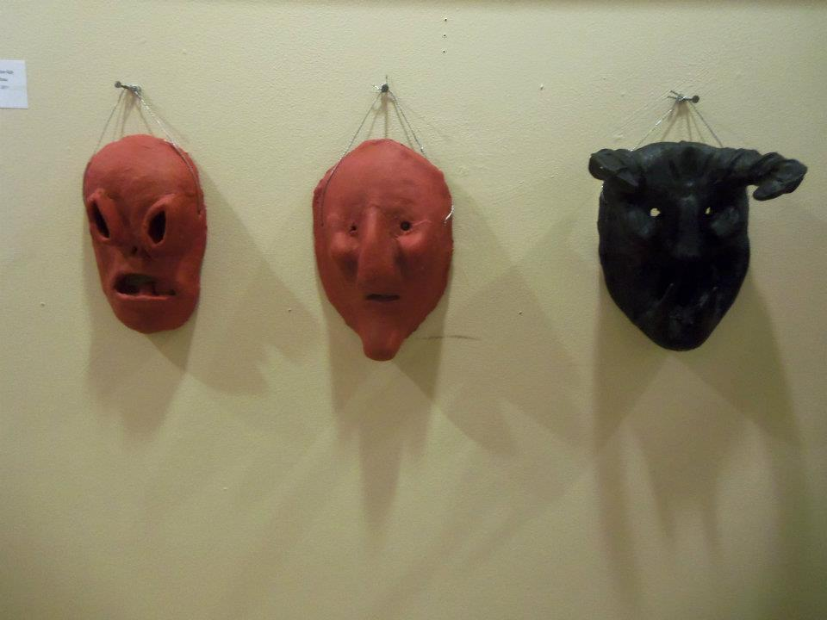
Super Ego, Ego, and Id. Clay and Acrylic December 2011 Roughly 25.4” x 16.5” each

Slide 5
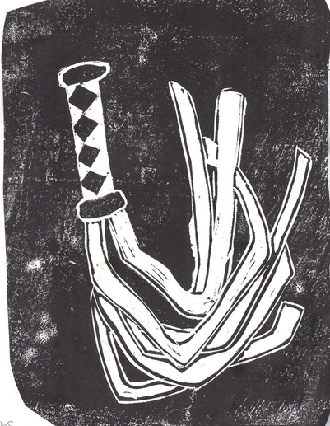
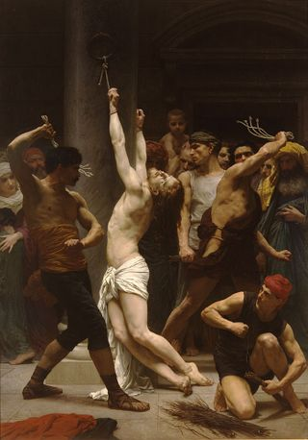
Punishment Ink on paper December 2011
20.3” x 27.9”

Slide 6
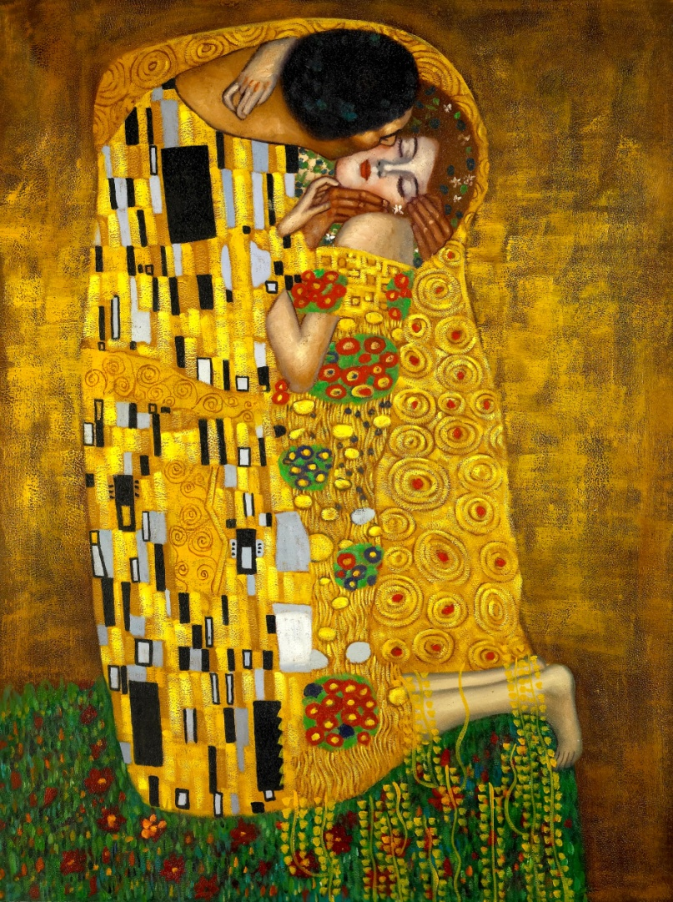
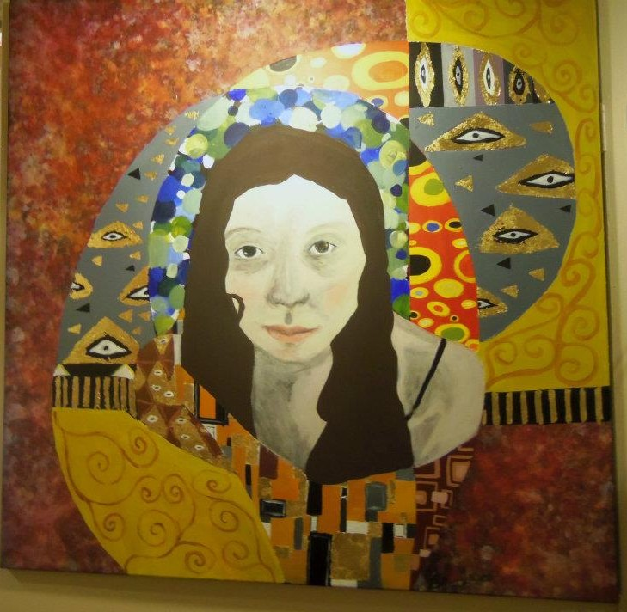
Self Portrait Acrylic and Gold Leaf on Canvas January 2012 121.9 cm x 121.9 cm

Slide 7
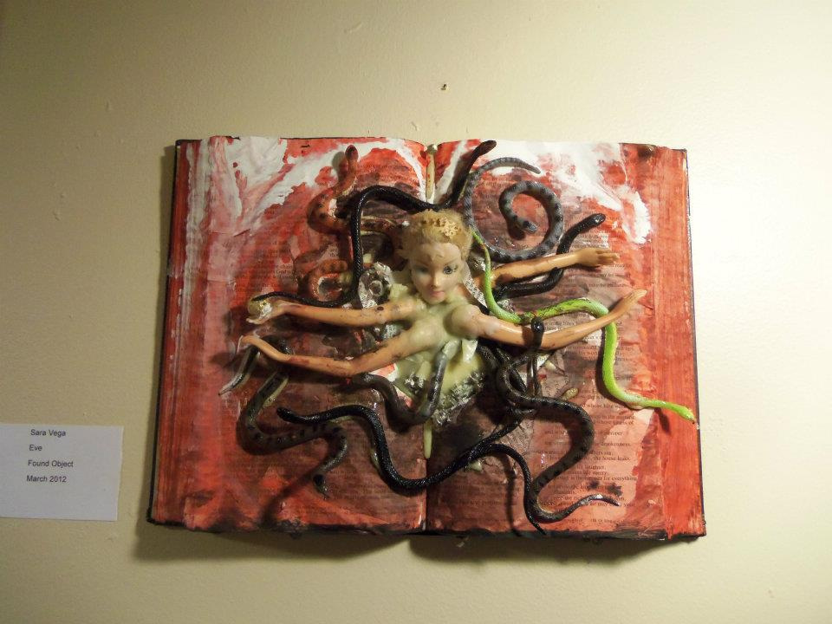
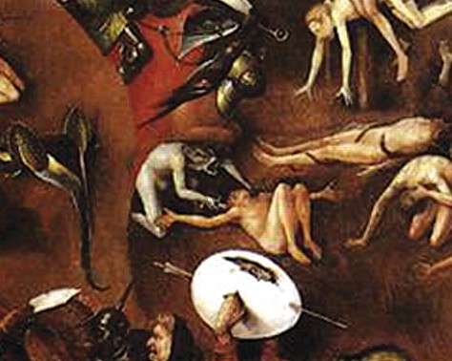
Eve Found Object May 2012
15.2cm x 20.3cm

Slide 8
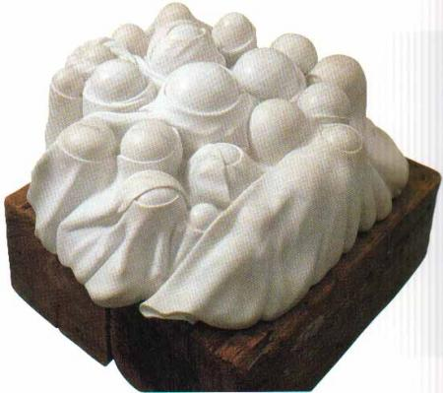
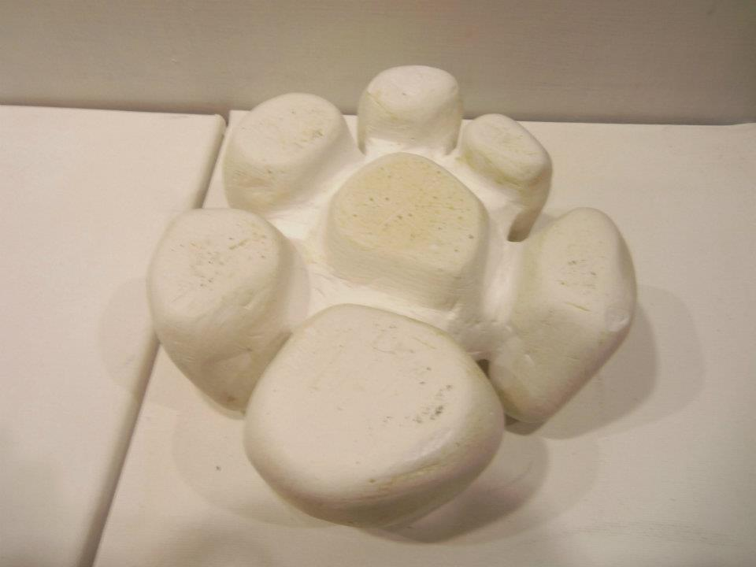
Septuplets Plaster May 2012
10.2 cm x 20.3 cm

Slide 9
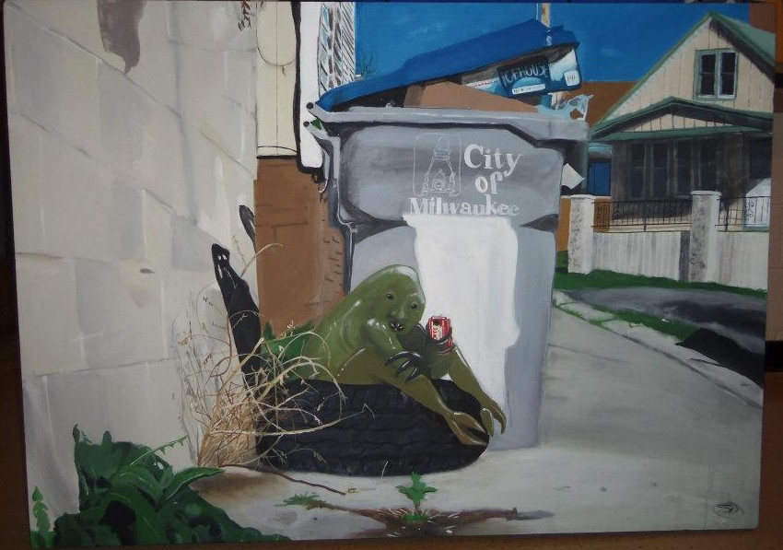
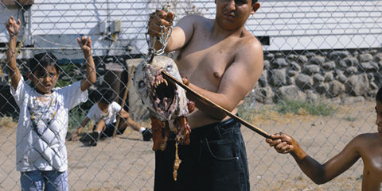
Immigrant Acrylic on Canvas May 2012 91.4 cm x 121.9 cm

Slide 10
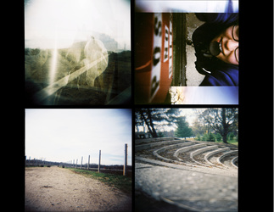
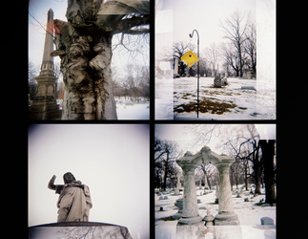
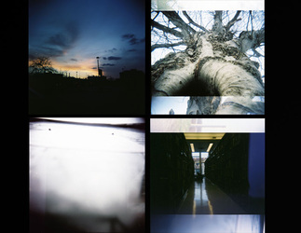
HOLGA 120 HOLGA CAMERA

